Slide 1
Windows Azure Virtual Machines

Slide 2
Agenda
Windows Azure VMs
Getting Started with VMs
Managing VMs
Managing VMs with PowerShell
Understanding Linux VMs

Slide 3
Windows Azure VMs

Slide 4





A Continuous Offering From Private to Public Cloud
Physical
Virtual
IaaS
PaaS
SaaS
Notes:
Slide Objective:
Microsoft provides a continuous solution from private cloud to the public cloud. No matter where you are on your technology roadmap we have a solution to fit your needs.
We are a trusted advisor and platform in the traditional enterprise and ISV space and with the new IaaS offering we are making it easier to bring this same level of trust and ease of use to the public cloud.

Slide 5
Windows Azure Virtual Machines
IT Pro experience
Support for key server applications
Easy storage manageability
High availability features
Advanced networking
Integration with compute PaaS

Slide 6


Cloud First Provisioning
Getting Started
Select Image and VM Size
New Disk Persisted in Storage
Windows Server
Management Portal
Boot VM from New Disk
Linux
>_
Extra Small
Small
Medium
Large
X-Large
Scripting
(Windows, Linux and Mac)
Cloud
REST API
Notes:
Slide Objective:
Explain workflow for provisioning VMs in the cloud
Notes:
Cloud First Provisioning means exactly what is says. Building a VM in the cloud first.
You have three methods of starting this process: Build a VM from the portal, from the command line OR programmatically calling the REST API.
Once your choice of provisioning is made you will need to select the image and instance size to start from.
The newly created disk will be stored in blob storage and your machine will boot.

Slide 7
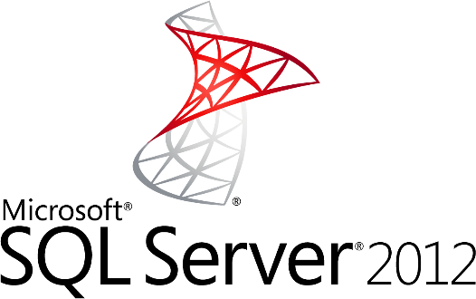
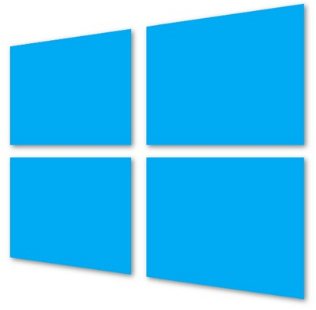
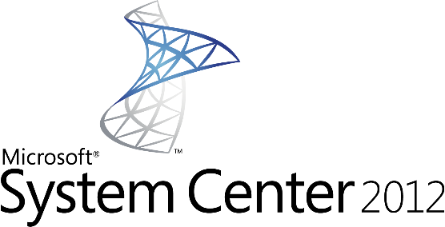

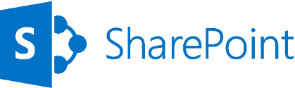
Supported Windows Server Applications
SQL Server 2008
SQL Server 2008 R2
SQL Server 2012
Windows Server 2008 R2
Windows Server 2012
SharePoint 2010 & 2013
BizTalk 2010 & 2013
System Center 2012
http://support.microsoft.com/kb/2721672
Notes:
Windows Server Windows Server 2008 R2 and later versions are supported for the following roles:
Active Directory Domain Services
Active Directory Federation Services
Active Directory Lightweight Directory Services
Application Server
DNS Server
Fax Server
Network Policy and Access Services
Print and Document Services
Web Server (IIS)
Windows Deployment Services
Windows Server Update Services
File Services

Slide 8





Linux on Windows Azure
We will support
SUSE SLES 11 sp2
Open SUSE 12.1
CentOS 6.2 by OpenLogic*
Ubuntu 12.04
Specific versions are endorsed
Integration Components
Testing and validation by partners
Bring other variants at your own risk**
*Image provided by OpenLogic based on CentOS 6.2
**Integration Work will be needed
Notes:
Slide Objectives:
Provide an understanding of which Distributions of Linux are offered in the Windows Azure Image Gallery.
Speaking Points:
1) Only Certain distributions of Linux are officially supported: SUSE Enterprise 11 SP2, OpenSUSE 12.1, CentOS 6.2, Ubuntu 12.04
2) Virtual Machine Images of these Distributions are provided by Partners who are experts in each distribution
3) Other Distributions of Linux can be installed as “Bring-Your-Own-Linux” however, some integration work will be needed.
Notes:
Linux Virtual Machines Product Page: http://www.windowsazure.com/en-us/manage/linux

Slide 9


Gallery Images Available
Microsoft
Windows Server 2008 / 2012
SQL Server Eval
BizTalk Server
Visual Studio 2013
Open Source
OpenSUSE 12.2
CentOS 6.3
Ubuntu 12.04/12.10
SUSE Linux Enterprise Server 11 SP2

Slide 10
Virtual Machine Sizes
VM Size | CPU Cores | Memory | Bandwidth | # Data Disks
Extra Small | Shared | 768 MB | 5 (Mbps) | 1
Small | 1 | 1.75 GB | 100 (Mbps) | 2
Medium | 2 | 3.5 GB | 200 (Mbps) | 4
Large | 4 | 7 GB | 400 (Mbps) | 8
Extra Large | 8 | 14 GB | 800 (Mbps) | 16
Each Persistent Data Disk Can be up to 1 TB
Notes:
Slide Objective:
VM sizes

Slide 11



Linux Offering
1ST
First Class Citizen
Enterprise + ISV
Open Source Community
Support
Notes:
Slide Objectives:
Provide a better understanding of Microsoft’s Linux offering on Windows Azure
Speaking Points:
1) Linux as a first class citizen in Azure
2) We will focus mainly on Enterprises and ISVs but will also reach out to the community
a) Open Sourcing critical components
b) Documenting API
3) We will offer both Community and Commercial Distributions
4) You will be able to buy support for the commercial distributions (GA only)
Transitions:
1) First Class Citizen
2) Enterprise + ISV
3) Open Source Community
4) Support
Notes:
Any notes go here

Slide 12
Virtual Machines and Cloud Services

Slide 13

Cloud Services, Roles, and Instances
WEB ROLE
Cloud Service is a…
Management
Configuration
Security
Networking
Service Model
boundary
VM 1
VM 2
VM 3
ROLES
INSTANCES
WORKER ROLE
VM 4
VM 5
VM…

Slide 14
Cloud Services with Virtual Machines Multiple Virtual Machines can be hosted within the same cloud service
Cloud Service
VM 1
VM 2
VM 3
VM 4
Notes:
There are default limits in Azure as follows:
20 Hosted Service Projects
5 Storage Accounts
5 roles per Hosted Service (i.e. 3 different web roles + 2 different worker roles or any such combination)
20 CPU cores (not instances) across all your Hosted Service Projects
(http://blogs.msdn.com/b/jnak/archive/2010/01/22/windows-azure-instances-storage-limits.aspx)

Slide 15



Multiple Cloud Services Configuration
LB
WEB
AD/DC/DNS
SQL
AD 1
Cloud Service 2
80/443
VPN Tunnel
Corp Users
Cloud Service 1
Azure
OnPrem

Slide 16
Getting Started with Virtual Machines
Notes:
Use DEMO-GettingStartedVMs

Slide 17
Virtual Machine Availability

Slide 18
Service Level Agreements
Availability set
99.95% for multiple role instances
4.38 hours of downtime per year
Server 1
Server 2
What’s included
Compute Hardware failure (disk, cpu, memory)
Datacenter failures - Network failure, power failure
Hardware upgrades, Software maintenance – Host OS Updates
What is not included
VM Container crashes, Guest OS Updates
SLA 99.95
Notes:
Slide Objective:
You need an availability set for a 99.95% SLA
Notes:
Without at least two virtual machines performing the same workload grouped into an availability set you get a 99.95% SLA.

Slide 19
Fault and Update Domains
Fault Domains
Represent groups of resources anticipated to fail together
i.e. Same rack, same server
Fabric spreads instances across fault at least 2 fault domains
Update Domains
Represents groups of resources that will be updated together
Host OS updates honour service update domains
Specified in service definition
Default of 5 (up to 20)
Fabric spreads role instances across Update Domains and Fault Domains
Notes:
Slide Objective:
Discuss achieving very high availability with Windows Azure
Notes:
Fault Domain is a physical unit of failure, and is closely related to the physical infrastructure in the data centers.
In Windows Azure the rack can be considered a fault domain. However there is no 1:1 mapping between fault domain and rack.
Windows Azure Fabric is responsible to deploy the instances of your application in different fault domains.
Obviously this only applies if you run more than 1 instance
Right now Fabric makes sure that your application uses at least 2 (two) fault domains, however depending on capacity and VM availability it may happen that it is spread across more than that.
As a developer u have no direct control over how many fault domains your application will use but the way you configure it may impact your availability
Upgrade Domain is a logical unit, which determines how particular service will be upgraded.
The default number of upgrade domains that are configured for your application is 5 (five). You can control how many upgrade domains your application will use through the upgradeDomain configuration setting in your service definition file (CSDEF).
Windows Azure Fabric ensures that particular upgrade domain is not within single fault domain
That is Upgrade domains are orthogonal to fault domains
Roles are then spread out over upgrade domains and fault domains. Subject to running a reasonable number of instances this removes the risk of a single point of failure

Slide 20
Fault and Update Domains
Fault Domain
Fault Domain
Rack
Rack
Web Role
UD #1
UD #2
INSTANCE
INSTANCE
INSTANCE
INSTANCE
Worker Role
UD #1
UD #2
INSTANCE
INSTANCE
INSTANCE
INSTANCE
Notes:
Slide Objective:
Provide a graphical view of fault and upgrade domains for existing web and worker roles. Use to contrast existing skills with availability sets.
Notes:
You can see that our service is well spread out across both fault and upgrade domains
The loss of a fault domain will not cause a failure of our service nor will the restart or change of an upgrade domain cause a failure of our service
Notes
Useful pre-reading here.
http://blog.toddysm.com/2010/04/upgrade-domains-and-fault-domains-in-windows-azure.html

Slide 21
Virtual Machine Availability Sets Update Domains are honored by host OS updates
Fault Domain
Fault Domain
Rack
Rack
Virtual Machine
Virtual Machine
Availability Set
IIS1
IIS2
UD #1
UD #2
Availability Set
Virtual Machine
Virtual Machine
SQL1
SQL2
UD #1
UD #2
Notes:
Slide Objective:
Explain availability sets
Notes:
Availability sets tell the Fabric Controller to place VMs in the same set on different racks for faults and in separate upgrade domains for updates.
This essentially tells the FC not to take the guest OS down of all VMs in the same set for host updates.

Slide 22

End to End Highly Available Solution Redundancy at every level
SQL Server1
SQL-AVSET
Internet
IIS Web Application
IIS-AVSET
Web Role
SQL Mirroring
LB
IIS Web Application
SQL Server2
Web Role
Notes:
Slide Objective:
Explain that each tier of an application can be enabled with its own availability set which ensures at a physical hardware level in the data center that there is no single point of failure.

Slide 23
Configuring Load Balancing and High Availability
Notes:
Slide Objective:
DEMO
Notes:
See DEMO-LoadBalancingAvailability

Slide 24
Images & Disks

Slide 25

Persistent Disks and Highly Durable
Windows Azure Storage (Disaster Recovery)
Windows Azure Storage
Virtual Machine
Notes:
Slide Objective:
Explain how disks are durable and how Windows Azure storage works
Notes:
The OS and Data Disks are stored in Windows Azure storage. So in addition to the data being persistent you also get the benefits of storage which means your VHD is replicated 3X’s locally and also 3X’s in a separate data center in the same region (geo-replication)

Slide 26
Persistent Disks and Highly Durable
Windows Azure Storage (Disaster Recovery)
Windows Azure Storage
Virtual Machine
Virtual Machine
Notes:
Slide Objective:
This slide simply highlights that if the physical hardware backing your VM goes down a new server will start and pick up the same VHD.

Slide 27
Disks and Images
OS Images
Microsoft
Partner
User
Base OS image for new Virtual Machines
Sys-Prepped/Generalized/Read Only
Created by uploading or by capture
Disks
OS Disks
Data Disks
Writable Disks for Virtual Machines
Created during VM creation or during upload of existing VHDs.
Notes:
Slide Objective:
Explain the differences between disks and images with VMs

Slide 28
Image Mobility
On-Premises
Cloud
MyApp.vhd
Notes:
Slide Objective:
Explain the benefits of image mobility
Notes:
One of the key benefits of IaaS is flexibility and control. The Windows Azure solution provides the capability of not only moving VHDs TO the cloud but also allows you to copy the VHD back down and run it locally or on another cloud provider. Great for testing out production issues or any other need where you require a copy of the production server.

Slide 29
Bring Your Own Server/VHD
On-Premises
Cloud
MyApp.vhd
On Premises Virtual Server
Provision VM from Image or Disk using portal, script or API
Use Case
Forklift Migration of VMs
Sys Prepped Images
VHD Must Be Fixed Disk
* CSUpload Can Convert on Upload
Upload VHD
Create Disk or
Image
Notes:
Slide Objective:
Explain workflow for bringing your own VHD
Notes:
This use case is when you already have a “golden image(s)” your company uses for server provisioning or you have a VM running on premises that you would just like to run in our data center. You take the vhd – use CSUpload or System Center App Controller to upload as a page blob to a storage account. From there use the portal to add as an image (sysprepped) or disk (configured VM) and there you can create a VM based off of the vhd.

Slide 30
Imaging VMs in the Cloud
Cloud
Base.VHD
Identical/similar deployment instances using common OS image as start
Boot
VM
Customize
VHD
Generalize
VHD
Capture
VM
Capture VM Saves Customized Image to Your Image Library
Notes:
Slide Objective:
Explain workflow for creating a custom image in the cloud
Notes:
This use case is all about using the capture feature of IaaS to create OS images. The first part you start with a base vhd that you then custom with software binaries, registry settings etc.. You run sysprep.exe and generalize/shutdown the OS. You can then upload it if coming from on-premises or just click the capture button if you created the VM in the cloud.
Capture allows you to take a generalized VM and save the underlying VHD as a new image in your image library.

Slide 31
What will work on upload…
Images
Sysprep’d Windows Server OS
VHD on Hyper-V
(Server 2008 R2 and Windows Server 2012)
Windows Azure Image
Windows Server
VHD on Hyper-V
(Server 2008 R2 and Windows Server 2012)
Windows Azure Disk
Disks

Slide 32
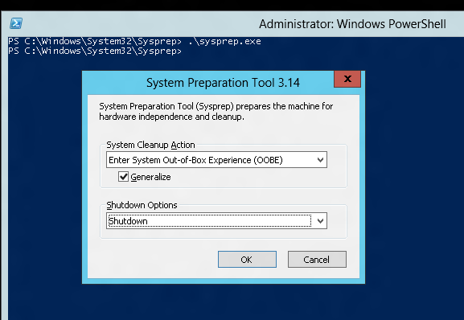
Tips on BYO Generalized Images
Sysprep and “Generalize” is expected
Do NOT put unattend.xml on the disk
Do NOT install the Windows Azure Integration Components!!
No WA Agent

Slide 33
Imaging Virtual Machines

Slide 34
Managing VMs

Slide 35



Manage using existing Tools
Windows Intune
Macs
X86/x64
AD
Windows Server 2012
Windows RT
VPN Tunnel
Windows Phone 8
iOS
Windows Server 2012
Windows Server 2008
Windows Server 2003
Windows Server 2008
Windows Server 2003
Android
OnPrem
Azure
Internet

Slide 36
Scripting Capabilities
Full Support for IaaS
Windows Azure PowerShell Cmdlets
Cross Platform Scripting Built on node.js
Capabilities
Provisioning, Removal
Reboot, Start Import and Export VM settings
Support for Windows and Linux VMs
Domain Join at Provision for Windows
Fully Customize VM with Data Disks and Endpoint Configuration
Automate Virtual Network Settings
Notes:
Slide Objective:
Highlight some of the functionality available to Windows Administrators to automate management / provisioning of virtual machines in the cloud.

Slide 37
What can you do with PowerShell?
Automation
Query, Manage and Configure Virtual Machines across multiple subscriptions, cloud services and storage accounts.
Provision Fully Configured Virtual Machines
Domain Joined
Storage and Networking Configured
Virtual Networking
Completely Configure VNETs from a Script

Slide 38
Virtual Machine Management
Quick VM Provisioning Mode
Supports VM Creation in a Single Cmdlet
Advanced Provisioning Configuration Mode
Provision With: Endpoints, Data Disks
Configure: Cache Settings for OS/Data Disks and Subnet Names
Create Multiple Pre-Defined VMs in a Batch
New-AzureVM -VMs $vm1, $vm2, $vm3

Slide 39
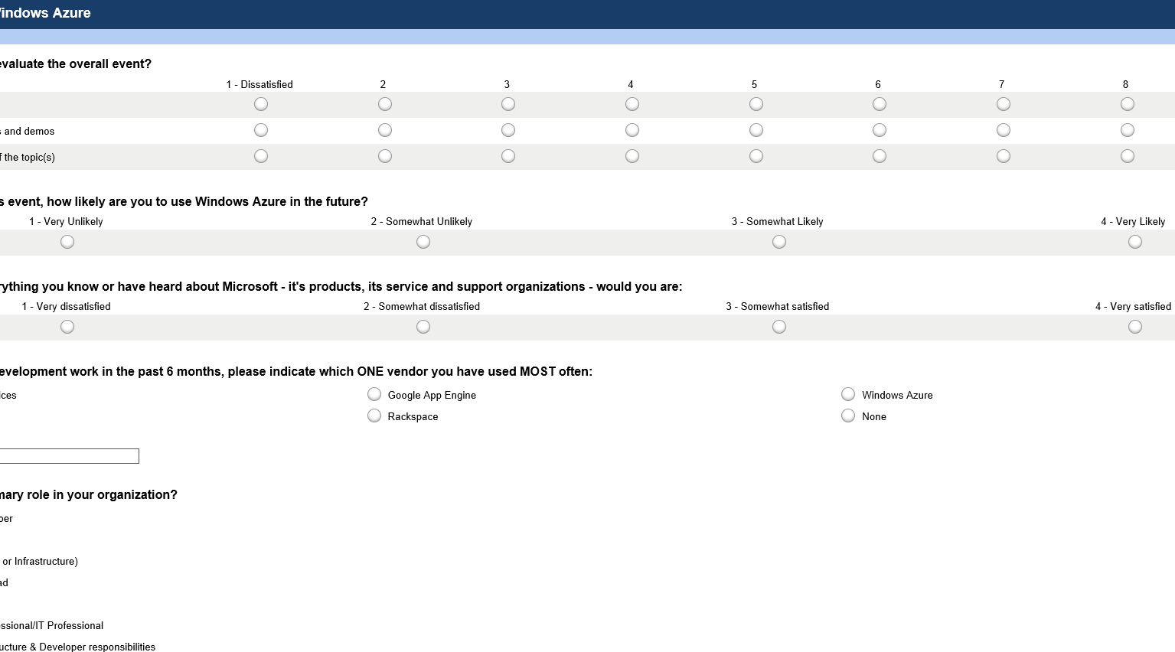

Take the DevUnleashed Windows Azure Survey
Your feedback, helps us make these events available to your community, please fill it out sometime today.
www.surveymonkey.com/s/azureunleashed

Slide 40
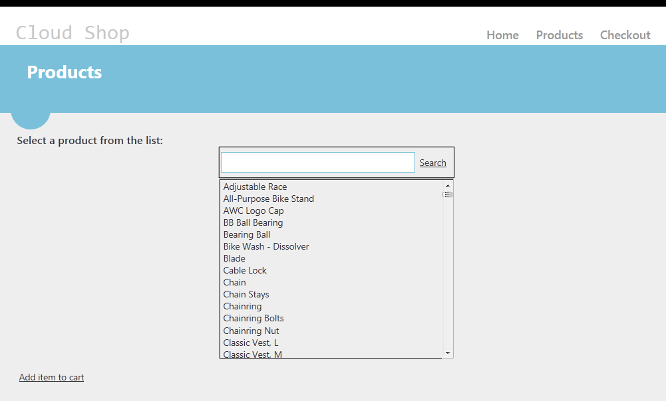
HANDS ON LAB
Introduction to Windows Azure Virtual Machines (Windows or Linux)
Creating Virtual Machines for IIS
Creating a SQL Server Virtual Machine
Deploying a Simple MVC4 Application
Or
Creating a Linux Virtual Machine in Windows Azure
Installing and Configuring the Virtual Machine
Installing and Configuring Drupal

Slide 41
Thank You!

